Slide 1
CS462 Senior Software Engineering Project: Winter Pre-Release Prototype a web-based tool for creating and executing task-delineated, collaborative, AI-assisted assignments
Group 28:
Oliver Zhou, Ethan Lu, Trent Matsumura, Collin Kimball, Sai Anand

Slide 2
Introduction
This project is a Consultancy project for our project mentor, Sanjai Tripathi.
This project is a website that acts as a more extensively featured Learning Management System, similar to Canvas.
Key Features:
Task-delineation
AI-integration

Slide 3
Problem Statement
Assignments are limited in their ability to represent complex structures in standard Learning Management Systems i.e. Canvas.
Additionally, students are encouraged or incentivized to use AI tools to quickly finish assignments, which isn’t productive for improving mental fitness.
Punishing AI use does not stamp out the root of the problem, and misses the opportunity to use the technology for our advantage. There is a need for a solution that addresses both task organization and AI-integration in Learning Management Systems.

Slide 4
Key Requirements and Updated Roadmap
Winter Sprint 1
Winter Sprint 2
Winter Sprint 3
Winter Sprint 4
End of Winter
Spring Term
Exporting Assignment Objects
Tracking and Analyzing Student Activity
Configure AI Tools
Organized Assignment and Task Creation
Metacognitive Bot
Deployment and Testing With Students
Instructors can generate exportable or pasteable versions of their delineated assignments
Instructors can track students’ progress through tasks and utilization of AI and receive analytic reports on both
Instructors can configure AI assistance for specific tasks, tailoring chatbot responses to assist students
Instructors can create assignments within a web tool, breaking them down into multiple delineated tasks
A bot that can understand the context of course material
The product will be tested and improved upon using real data from student testers.

Slide 5
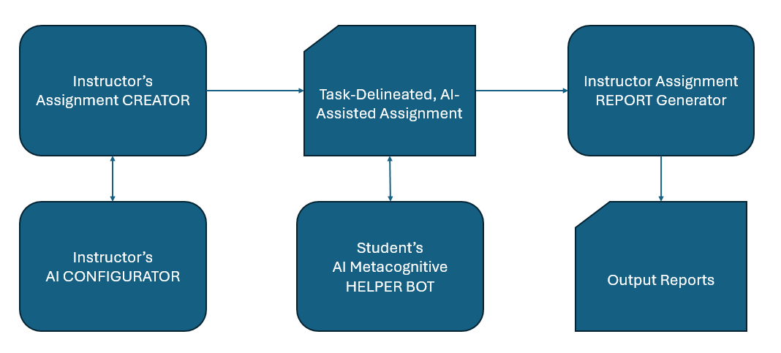
Design Overview
The project design is split into two core components.
Frontend: A web-based user interface that allows students and teachers to execute tasks.
Backend: A server backend that implements functionality and interacts with an AI API for AI chat responses.

Slide 6
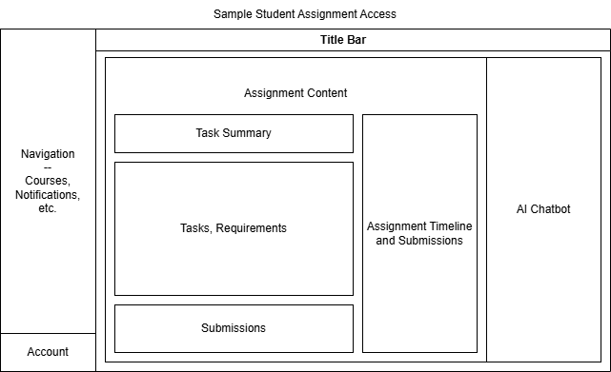
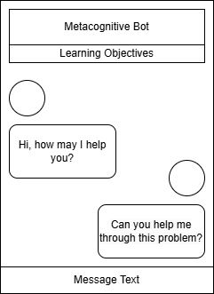
Design Mockups
Assignment Creation Page - Prototypes AI Helper Bot

Slide 7
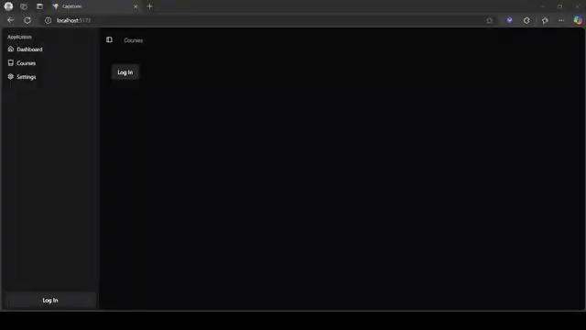
Functionality Demo
The implementation and deployment of our project will now be demonstrated.

Slide 8
Verification and Validation
The current outcome meets the primary key requirements. Both of the issues from the problem statement are addressed with features that allow complex homework organization as well as AI-integrated chatbots to assist student learning.
Project Mentor Feedback
He is happy with the progress of the winter term, and is looking forward to testing the product with students
Looking to deploy the product on a web host and looking for further communication with the team

Slide 9
Next Steps
In the spring term, we will:
Move our software to the OSU engineering servers rather than having to run it locally.
Deploy our software to real world scenarios, allowing students and teachers to test and give feedback. Much of our testing will be done with our project mentor’s students.
Implementing additional quality of life features to our software, such as configurable chatbots and chatbot summaries of student interaction.

Slide 10
Thank You!

